Slide 1
CP1: Employee Turnover DATA Analysis
Milestone Report 1

Slide 2
About dataset
Simulated employee data of a large company facing problem of high turnover
14999 samples of employees classified into two categories: Left and Stayed
Other columns
Salary
Satisfaction level
Last Evaluation
Number of projects
Average monthly hours
Time spent in the company
Work accidents
Promoted in the last five years
Department
Data can be downloaded at: https://www.kaggle.com/ludobenistant/hr-analytics

Slide 3
Limitations
Since this is a simulated dataset, it is not possible improve the model as new data becomes available
The dataset is imbalanced, there are more samples available for employees that stayed vs. left (Based on 24% Turnover, 24% of records correspond to employees that left and the remaining correspond to the ones that stayed)

Slide 4
Cleaning and Wrangling
Checked data for null values, Nan, unexpected formats (using regex)
Renamed columns with easy to understand names
Checked if the data is tidy. Tidy data follows these rules
Each variable must have its own column.
Each observation must have its own row.
Each value must have its own cell. Classified columns into Qualitative vs. Quantitative

Slide 5
Exploratory Data Analysis
“The greatest value of a picture is when it forces us to see what we never expected to see”- John Tukey

Slide 6
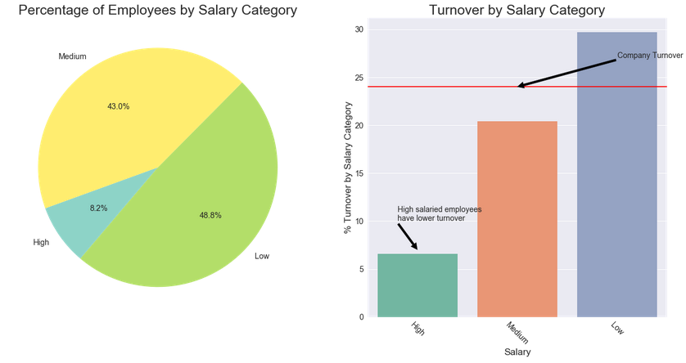
Salary
Majority of employees have Low/Medium salaries
Low/Medium salaried employees have significantly higher turnover

Slide 7
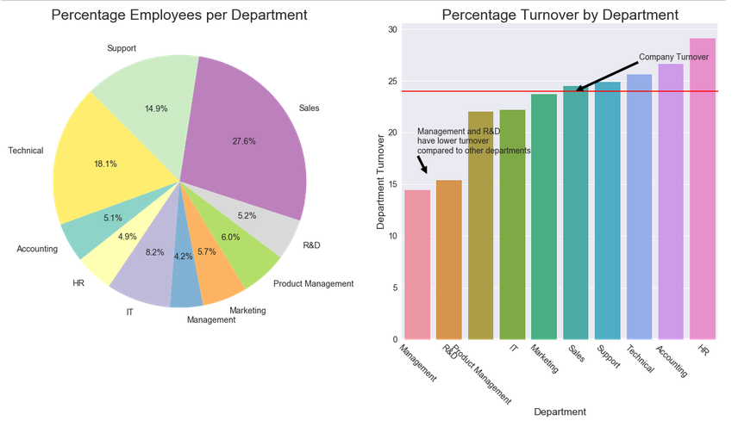
Department
Majority of employees are in Sales, Technical and Support departments.
R&D and Management have a lower turnover compared to other departments.

Slide 8
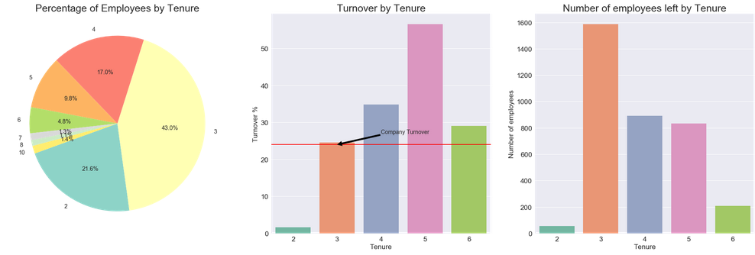
Tenure
Most employees have a tenure between two to five years
Most employees leave during their third to sixth year of service

Slide 9
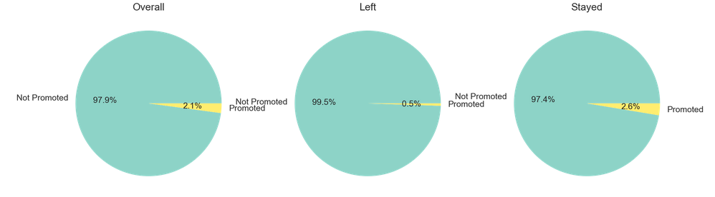
Promotion in last 5 years
Very few employees have been promoted in the last 5 years overall
% of promotions is better among the employees that stayed

Slide 10
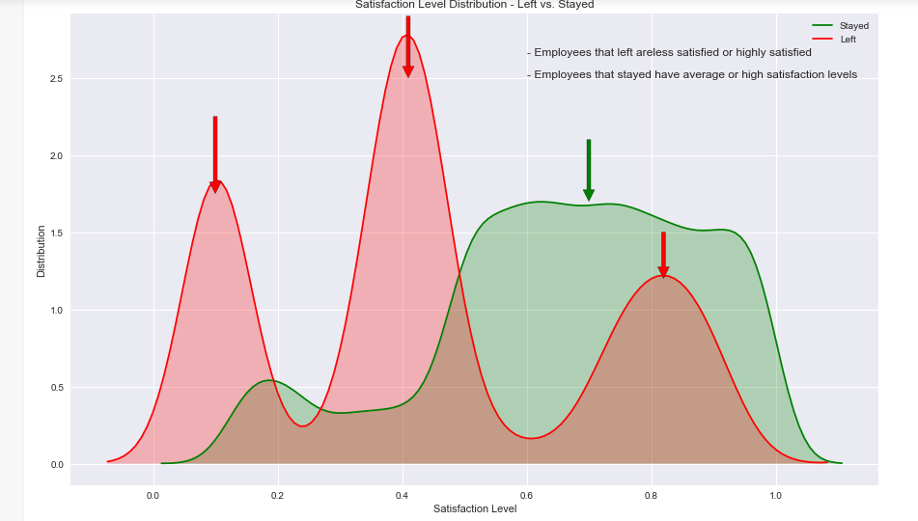
Satisfaction Level
Employees that left are either less satisfied or highly satisfied
There are very few employees among the ones that stayed that are less satisfied

Slide 11
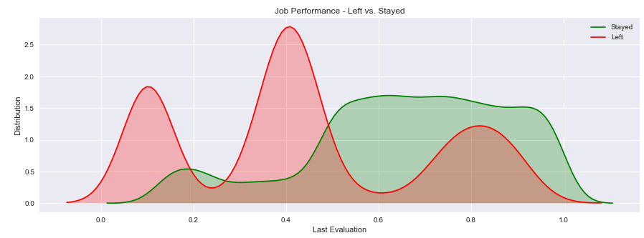
Job Performance
Employees that left worked too few or too many hours
Employees that stayed are evenly distributed across a wide range of average hours worked

Slide 12
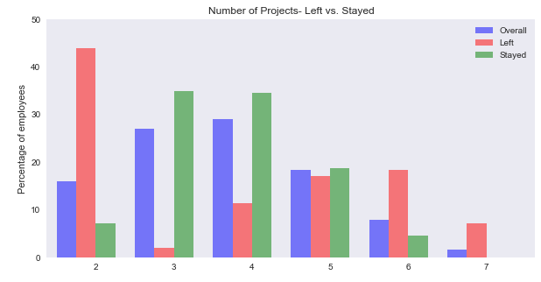
Number of projects
Employees that left worked on too less or too many projects

Slide 13
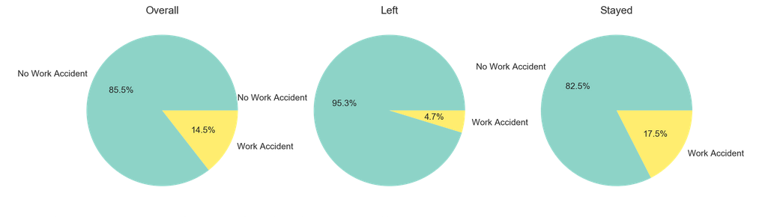
Work Accidents
Employees that left had fewer accidents compared to the ones that stayed

Slide 14
Inferential Statistics
Used Chi-squared test to determine if the differences in groups were statistically significant
Consequently ran pair-wise chi squared tests to understand if there were any groups where the differences were significantly higher
All tests confirmed the inferences drawn from visual EDA

